Slide 1

Mapping Space Trash
Team Lost Sky

Slide 2
index
Project Description
Project Methodology
Key Findings/Results
Research drilldown
Conclusion

Slide 3
Team members
Natalia Rishma A – 2024 – SRMIST KTR
Chidambaram – 2025 – SRMIST KTR
Devansh Multani – 2025 – SRMIST KTR
Giri Prasad – 2025 – SRMIST KTR
Nayan Dhanadia – 2025 – SRMIST KTR
Vidhyuth Kasthurirangan – 2025 – SRMIST KTR

Slide 4
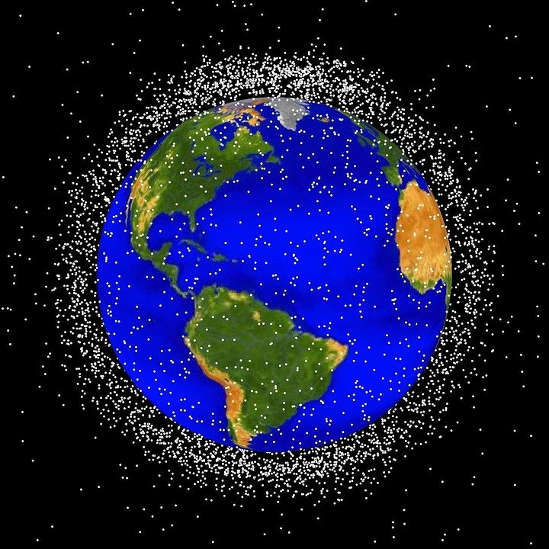
Problem statement: Mapping space trash
There are approximately 23,000 pieces of debris traveling at speeds up to 17,500 mph which can damage million dollar space equipment, operating in LEO(Low Earth Orbit). Measurements of near-Earth orbital debris are accomplished by using ground-based radars and optical telescopes, space-based sensors, analysis of spacecraft surfaces returned from space, and ground-based laboratory experiments, such as DebriSat. Another approach is to train Machine Learning Models and transmit their to spacecrafts in orbit and use them for these tasks. Our idea is to create a software to thermal screen every cross-sectional area (between latitudes and longitudes), and identify the position of the debris. We have found that every component sent to space has a very specific element called graphite epoxy, whose position can be identified even through space clouds.

Slide 5

USP
Using Artificial Neural Networks to image debris via telescopes in every grid formed by cross sections of longitudes and latitudes. After improving the pointing accuracy of the telescope through a deep learning technique, space debris with a cross-sectional area of 1 meter squared and a distance of 1500 kilometres can be identified accurately.

Slide 6
Future enhancements
Artificial Neural Network is being researched upon to help in better identification of space trash, and thermal screening might be able to give a rough location and approximate number of components present in a certain mapped region. We can conclude that trash won’t have to be added to pick up the already existing junk neither plan on giving such a haphazard idea.

Slide 7
Submission links
https://github.com/Astromonke/Space-trash-tracking

